Slide 1


VR STUDIOS
Jamin Harris, Oliver Lourie, Alex Yokubison, Yuhang Wu
Notes:
Chuck speaks first, introduce ourselves in order

Slide 2

Company Overview
Our company provides a platform that houses VR experiences from museums and attractions to schools and scholars worldwide.
Our service leverages existing VR hardware and software, as well as an optional professional content creation services, to bring immersive content to the classroom.
Notes:
Alex

Slide 3

Problem Statement
The academic environment is mostly constrained to the classroom.
Field trips allow students to learn in a more immersive setting.
Trips are limited by location, time, and expense.
Online learning is hindered by existing technology, the current pandemic highlights the need to improve technology implementation in the classroom.
Notes:
Alex
Field trip expansion

Slide 4



Solution Statement
To create the best user experience, a reliable platform will be developed by our business to deliver quality content including the key components:
VR pay per view application, allowing users to browse relevant educational content
Professional services offered to create high quality content, tailored to the needs of educators
Sale of recommended current market VR technologies and equipment
Notes:
Alex
Create an application where teachers can easily implement the virtual tours sold as pay-per-view, where the tour can be downloaded day-of to the headsets for ease of use with lesson plans.
We will offer professional services to create content, and are required for the initial burst of content within the first year and trial period
It will be made simple for schools to get the equipment by recommending goggles need. This is also applicable for creators to offer current VR cameras needed to create our films.

Slide 5
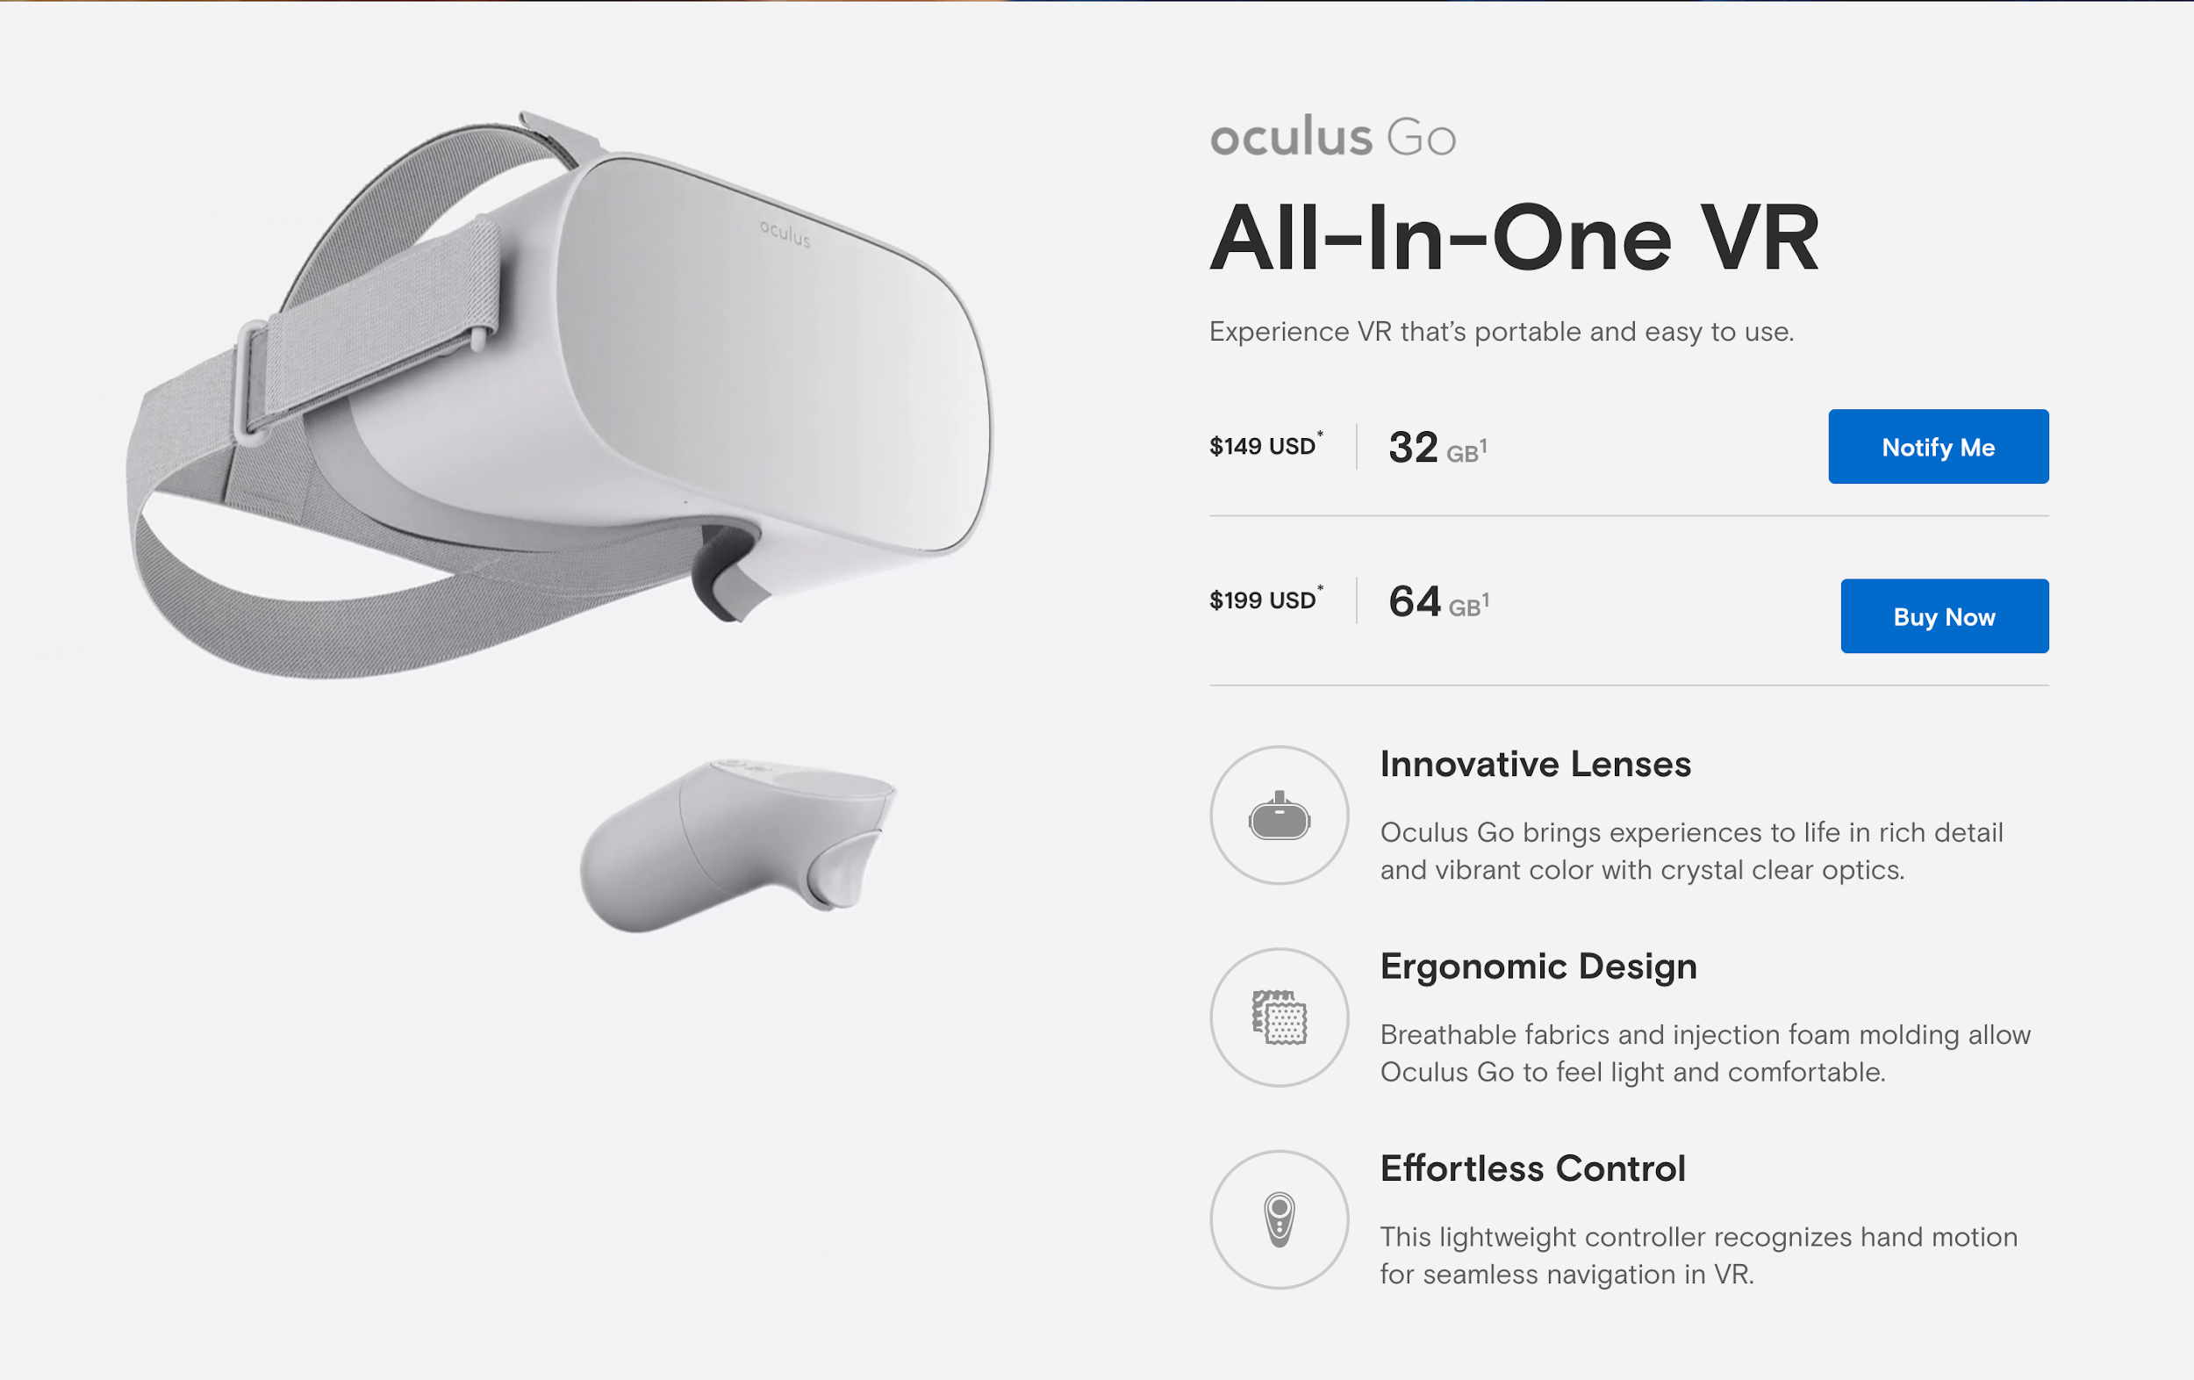
Existing Technologies
The VR hardware and software markets are rapidly developing.
VR technology is now more affordable than ever.
The market has already developed strong 360° video editing software for needs of content creators.

Slide 6

Market Opportunity
There are over 36,000 total high schools in the United States.
Average enrollment is 700 students
The average class size is 30 students
Schools are constantly looking to expand on educational experiences.
Existing VR technologies have the ability to bring new learning experiences to the classroom, in way that can be integrated with existing lesson plans and schedules.

Slide 7
What Makes Us Unique
Focus on cultivating an ecosystem of content that meets user needs and is tailored to specific learning goals and curricula.
Integrated hardware, software, and professional services that lower technical barriers of entry to schools and creators.
Exclusive high-quality video content from cooperation with museums and attractions around the world.
Preserve out-of-classroom learning even under emergency circumstances such as coronavirus.

Slide 8

Competition
Minor Competitor(s)
Youtube, PBS, other educational video services
Major Competitor(s)
Traditional Field Trips
Notes:
Chuck

Slide 9

Market Execution
Provide free professional services and content creation to build a library of educational resources.
Establish partnerships with top museums and attractions to create exclusive content.
Convince school districts of the worthiness of the product
Target private schools and large districts first.
Expand.
Notes:
Chuck

Slide 10
Financials
Year: | 2021 | 2022 | 2023 | 2024 | 2025
Revenue
Virtual admissions (Pay Per View) | $ - | $ 1,814,400.00 | $ 11,975,040.00 | $ 37,497,600.00 | $ 61,236,000.00
Headset Sales | $ - | $ 259,200.00 | $ 1,296,000.00 | $ 3,628,800.00 | $ 4,536,000.00
Professional Services | $ - | $ 625,000.00 | $ 1,000,000.00 | $ 1,000,000.00 | $ 1,000,000.00
Total Revenue | $ - | $ 2,698,600.00 | $ 14,271,040.00 | $ 42,126,400.00 | $ 66,772,000.00
Expenses
Salaries (Non-Professional Services) | $ 1,000,000.00 | $ 2,000,000.00 | $ 2,700,000.00 | $ 3,400,000.00 | $ 4,100,000.00
Content Hosting | $ 500.00 | $ 2,000.00 | $ 5,000.00 | $ 12,000.00 | $ 20,000.00
Professional Services
Salaries | $ 1,200,000.00 | $ 1,200,000.00 | $ 1,200,000.00 | $ 1,200,000.00 | $ 800,000.00
Equipment (PP&E) | $ 75,000.00 | $ 25,000.00 | $ 25,000.00 | $ 25,000.00 | $ 25,000.00
Royalty Expense | $ - | $ 1,270,080.00 | $ 8,382,528.00 | $ 26,248,320.00 | $ 42,865,200.00
General and Admin | $ 10,000.00 | $ 20,000.00 | $ 50,000.00 | $ 100,000.00 | $ 150,000.00
Total Expenses | $ 2,285,500.00 | $ 4,517,080.00 | $ 12,362,528.00 | $ 30,985,320.00 | $ 47,960,200.00
Profit | $ (2,285,500.00) | $ (1,818,480.00) | $ 1,908,512.00 | $ 11,141,080.00 | $ 18,811,800.00
Notes:
oliver

Slide 11
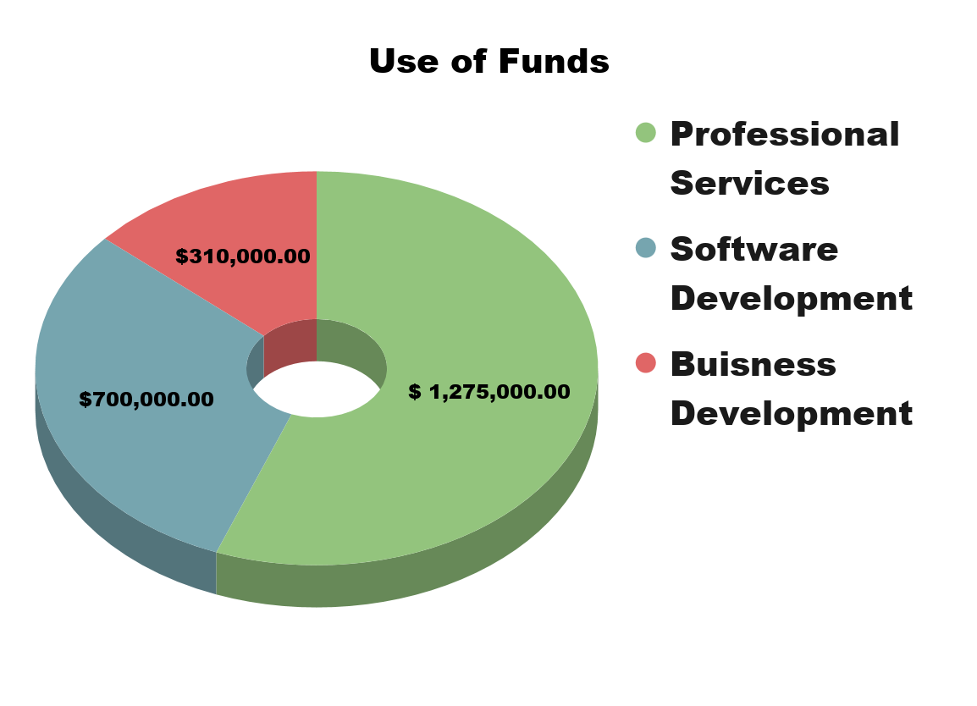
Use of Funds and Exit Strategy
Development of VR Headset Application and Content Hosting
Professional Services
Produce High Quality VR Educational Experiences, initially free of charge
Build a library of educational resources
Sell to Educational Publisher or Media Group
Notes:
oliver

Slide 12

Summary
Why we’re different
Our platform is dual sided. Creators can access the video production platform and consumers can use our streaming service to view groundbreaking immersive experiences.
Why we’ll succeed
Schools seek the most innovative technology to provide the best education.
Why you should invest
Early entrants to the forefront of the VR integration wave.
We are asking for $3 million in Seed funding for the first year and $1.5 million in Series A funds to develop a strong application and implement professional services to grow the content library.
Notes:
chuck

Slide 13
Questions?

Slide 14
Pricing Model
Year: | 2021 | 2022 | 2023 | 2024 | 2025
Students | 0 | 50400 | 302400 | 1008000 | 1890000
Views | 0 | 604800 | 3628800 | 12096000 | 22680000
Content Tiers
Good
Price | $1.00 | $1.00 | $1.00 | $1.00 | $1.00
Royalty (%) | 70.00% | 70.00% | 70.00% | 70.00% | 70.00%
Viewership (%) | 0% | 0% | 10% | 10% | 10%
Revenue | $0.00 | $0.00 | $362,880.00 | $1,209,600.00 | $2,268,000.00
Royalty Cost | $0.00 | $0.00 | $254,016.00 | $846,720.00 | $1,587,600.00
Better
Price | $2.00 | $2.00 | $2.00 | $2.00 | $2.00
Royalty (%) | 70.00% | 70.00% | 70.00% | 70.00% | 70.00%
Viewership (%) | 0% | 0% | 20% | 30% | 50%
Revenue | $0.00 | $0.00 | $1,451,520.00 | $7,257,600.00 | $22,680,000.00
Royalty Cost | $0.00 | $0.00 | $1,016,064.00 | $5,080,320.00 | $15,876,000.00
Best
Price | $3.00 | $3.00 | $4.00 | $4.00 | $4.00
Royalty (%) | 70.00% | 70.00% | 70.00% | 70.00% | 70.00%
Viewership (%) | 100% | 100% | 70% | 60% | 40%
Revenue | $0.00 | $1,814,400.00 | $10,160,640.00 | $29,030,400.00 | $36,288,000.00
Royalty Cost | $0.00 | $1,270,080.00 | $7,112,448.00 | $20,321,280.00 | $25,401,600.00
Total Revenue | $0.00 | $1,814,400.00 | $11,975,040.00 | $37,497,600.00 | $61,236,000.00
Total Royalty Cost | $0.00 | $1,270,080.00 | $8,382,528.00 | $26,248,320.00 | $42,865,200.00
Annual Views Per Student
12
Cost Per School Year (Average Enrollment)
$25,200.00
Cost Per Student
$36.00

